Slide 1

IBM SKILLSBUILD & AICTE INTERNSHIP 2026
ID: IBMUEML008058
INIDA-ML: Intelligent Network Intrusion Detection & Anomaly Analysis
Machine Learning Powered Network Flow Telemetry Inspection, URL Threat Detection & Automated Incident Response
Developer: Pappu Ramesh Baraf
Finolex Academy of Management and Technology, Ratnagiri
CSE (AI & ML)

Slide 2
Context & Challenge
The Network Intrusion Detection Challenge
Massive Telemetry Volume
High False Positive Rates
Fragmented Tooling
Enterprise flows contain millions of benign and malicious packets making manual auditing impossible.
Traditional signature systems fail to generalize against modern polymorphic network attacks.
Alerts, models, historical logs, and threat intelligence are frequently scattered across disconnected tools.
Project Solution: A unified Streamlit analytical workbench combining tabular Random Forest classification, URL threat detection, and live port auditing.

Slide 3

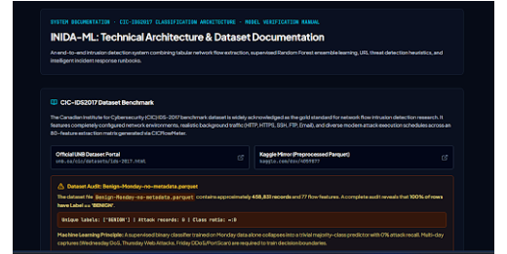
System Design
Technical Architecture & Dataset Benchmark
CIC-IDS2017 Dataset Benchmark
Gold-standard network flow dataset featuring 77 tabular flow parameters extracted via CICFlowMeter.
Rigorous Dataset Audit
The Benign-Monday file contains 458,831 records (100% Benign). Transparently handled to prevent classifier collapse.
INIDA-ML | System Documentation & Dataset Validation Module

Slide 4

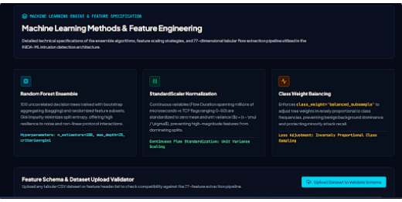
Machine Learning Core
Random Forest Ensemble & Preprocessing
Random Forest Classifier
100 estimators, max_depth=25, and Gini impurity optimization for robust non-linear classification.
StandardScaler & Balancing
Normalizes continuous features and enforces class_weight='balanced_subsample'.
INIDA-ML | Supervised Model Architecture & Feature Scaling

Slide 5
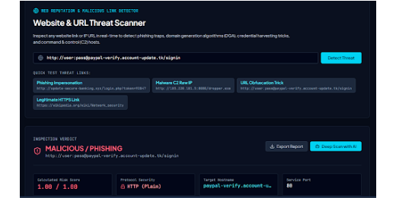
Threat Intelligence
Website & URL Threat Scanner Module
Phishing & DGA Detection
Inspects links in real time for credential harvesting traps, raw IP hosts, and high-risk domain extensions.
Instant Verdict & Export
Calculates precise risk scores and generates structured JSON reports or AI deep scans.
INIDA-ML | Web Reputation & Malicious Link Detector

Slide 6
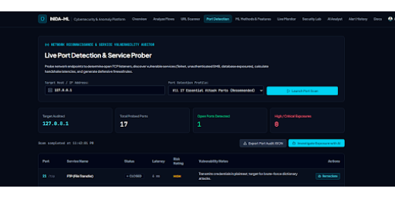
Network Auditing
Live Port Detection & Service Prober
17 Essential Attack Ports
Audits endpoints (Telnet, SMB, RDP, FTP) to discover open TCP listeners and calculate handshake latencies.
Automated Remediation
Generates defensive firewall rules and vulnerability notes for exposed services.
INIDA-ML | Network Reconnaissance & Vulnerability Auditor

Slide 7
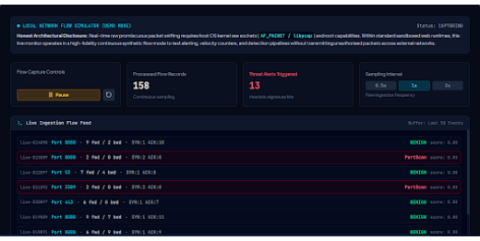
Real-Time Simulation
Live Network Flow Monitor & Ingestion Feed
Continuous Flow Simulation
Generates high-fidelity synthetic flow feeds to test velocity counters and heuristic detection without unauthorized packet capture.
Heuristic Signature Hits
Tracks processed records and triggers instant visual/audible alerts for anomalous PortScan and DoS activity.
INIDA-ML | Local Network Flow Simulator & Alert Engine

Slide 8
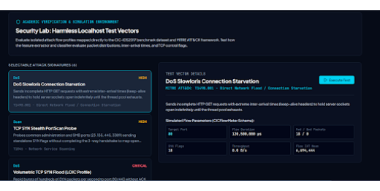
Simulation Sandbox
Security Lab: Harmless Localhost Test Vectors
MITRE ATT&CK Mapping
Evaluates isolated attack flow profiles mapped directly to T1498.001 (Slowloris) and T1046 (PortScan).
CICFlowMeter Parameter Testing
Inspects packet distributions, inter-arrival times, and TCP control flags safely in sandbox mode.
INIDA-ML | Academic Verification & Simulation Environment

Slide 9
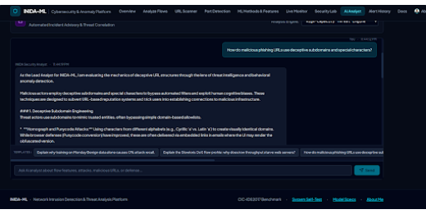
Generative AI Integration
AI Security Analyst & Incident Advisory
Dual-Engine LLM Support
Integrates Groq API and Gemini neural models to explain anomaly mechanics and deceptive subdomain structures.
Supplementary Advisory
Provides expert security recommendations without replacing deterministic machine learning classifiers.
INIDA-ML | Automated Incident Advisory & Threat Correlation

Slide 10
Strategic Impact
UN SDG Alignment & Lean Canvas Summary
SDG 9: Industry & Innovation
Local-First Architecture
Fosters resilient digital infrastructure and open-source cybersecurity tooling for academic research and small IT teams.
Combines offline CSV telemetry analysis, transparent evaluation metrics, and exportable reports in one dashboard.
Tech Stack: Python, Streamlit, pandas, scikit-learn Random Forest, Plotly, Groq API, pytest, and GitHub.
Status: Completed & Verified

Slide 11
FINAL DELIVERABLE PRESENTATION
Thank You & Questions
INIDA-ML is fully documented, tested, and ready for deployment on Streamlit Community Cloud.
Presenter
Institution
Internship ID
Pappu Ramesh Baraf
Finolex Academy, Ratnagiri
IBMUEML008058

